Slide 1


Randle High HOSA Chapter
Sponsored by Mrs. Kaila Williams, Health Science
Kaila.Williams@lcisd.org
Notes:
This PowerPoint is intended to introduce students to HOSA.

Slide 2









HOSA – Future Health Professionals is a:
Career and Technical Student Organization (CTSO)
Notes:
HOSA is a CTSO – a Career and Technical Student Organization. Other CTSOs include DECA, FBLA – Future Business Leaders of America (business), HOSA-Future Health Professionals, TSA (Technology Student Association), FFA, SkillsUSA, FCCLA – Family, Career and Community Leaders of America, BPA – Business Professionals of America.
Ask: Have you heard of these organizations before? Stand if you have been involved as a member in one of these organizations.
These CTSOs are leadership organizations for the following subject areas:
DECA – Marketing
Educators Rising – Teaching
FBLA – Business
BPA – Business
FFA – Agriculture
TSA – Technology
SkillsUSA – Skilled Trades
FCCLA – Family and Consumer Sciences
All CTSOs are similar in some ways: There are competitive events, there are leadership conferences, there are local, state and national officers

Slide 3




HOSA is…
100%
Health care!
Notes:
HOSA is an unique CTSO because it is 100% focused on health care

Slide 4

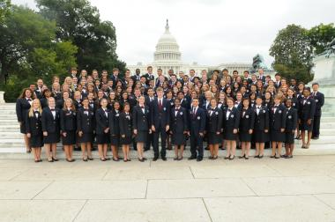
HOSA Membership
Middle School
Secondary (Highschool)
  Dues: $35 per student
    ($15 Texas Fee, $10 National Fee, & $10 Shirt Fee)
    Fall Conference $20
Postsecondary/Collegiate
Alumni
Professional
There are over 2.8 million students that have been involved in HOSA since 1976!
Notes:
There are four membership options in HOSA:
Secondary – for high school students
Postsecondary/Collegiate – for students in postsecondary programs (community college, university, etc)
Alumni – for those students that have graduated from high school – this option is FREE
Professional – for advisors, advisory committee members, other adults in the health profession that want to stay involved

Slide 5
HOSA Leadership
Chapter Level
  Chapter Advisor: Health Science Teacher
  Chapter Officers
    President:
    Vice President:
    Secretary
    Treasurer
    Historian
    Reporter
    Social Director
    Public Relations Officer
Notes:
HOSA has several leadership opportunities!
At the chapter level, the Health Science teacher serves as the chapter advisor
There are chapter officers

Slide 6
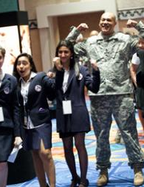


HOSA Leadership Opportunities
Regional Officer
State Officer
National Officer
Notes:
HOSA offers leadership opportunities beyond the chapter level – you can be a regional (if applicable), state or national officer!!

Slide 7


HOSA Conferences http://www.hosa.org/stateconferences
Fall Leadership Conference
  October 9, 2021 Cinco Ranch High
State Leadership Conference
  April 19-22, 2022 Galveston
International Leadership Conference http://ilc.hosa.org/
  June 22-25, 2022 Nashville, TN
Notes:
HOSA offers opportunities to meet and network with other students just like you through conferences!

Slide 8
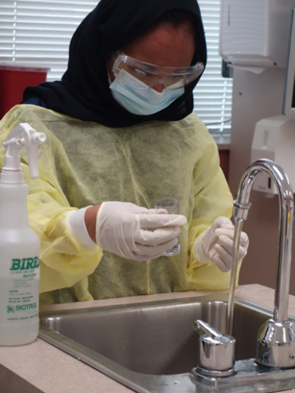
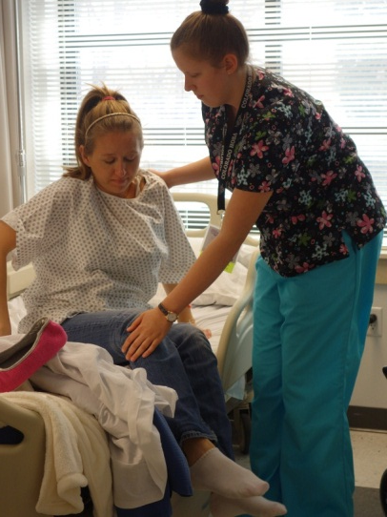
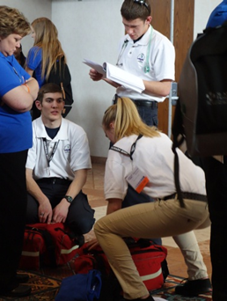

HOSA – Competitive Events
Health Science
Health Professions
Emergency Preparedness
Leadership
Teamwork
Recognition
61 EVENTS!!
Notes:
National HOSA offers 60 Competitive Events in 6 categories:
Health Science
Health Professions
Emergency Preparedness
Leadership
Teamwork
Recognition
To give students a list of Competitive Events, consider printing the “Selecting the Right Competitive Event” tool, found at http://www.hosa.org/Ceresources .

Slide 9



HOSA Online
www.hosa.org
Notes:
Visit the National HOSA website at www.hosa.org
Don’t forget to like and follow National HOSA and your State HOSA on Facebook, Twitter, Instagram and other social media!

Slide 10

@RandleHealthCTE
Notes:
This PowerPoint is intended to introduce students to HOSA.

