Slide 1
ESSER III Survey Results
K12 Insight Export
Copyright (c) 2002-2021 K12 Insight, LLC. All rights reserved

Slide 2
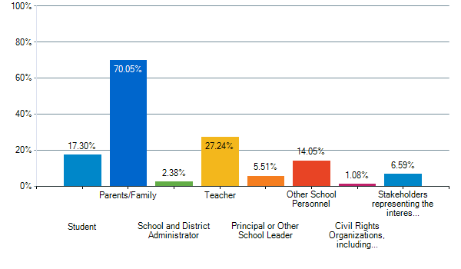
1. Please select your stakeholder category (select all that apply).

Slide 3
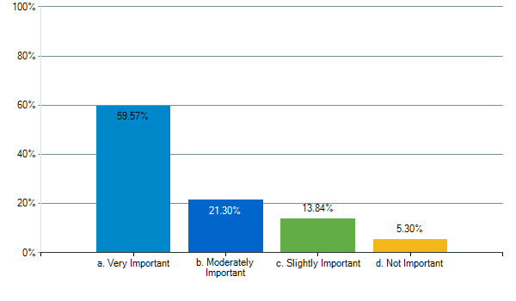
2. Provide tutoring, afterschool programs, summer learning programs, or additional school days to help students close learning gaps;

Slide 4
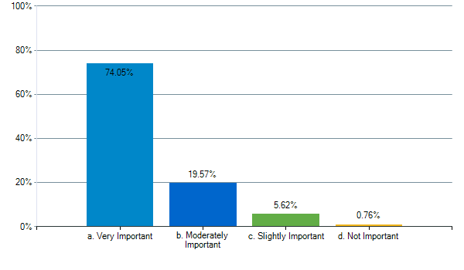
3. Provide instructional materials, resources, programs and/or activities;

Slide 5
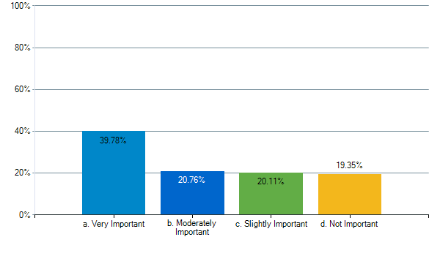
4. Improve student learning in virtual education and learning;

Slide 6
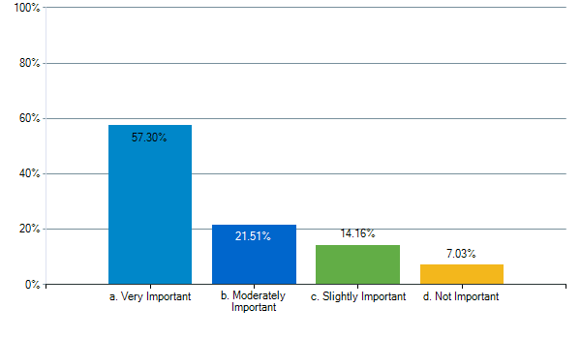
5. Provide technology (hardware, software, and connectivity) for online learning to all students, including assistive or adaptive technology for students with disabilities;

Slide 7
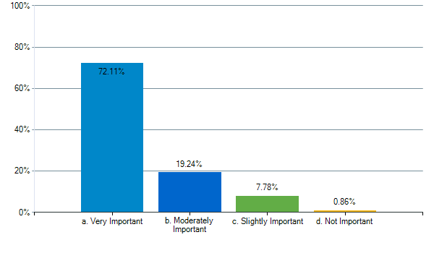
6. Provide activities to ensure the unique needs of children with disabilities are met and to prepare them for further education, employment and independent living;

Slide 8
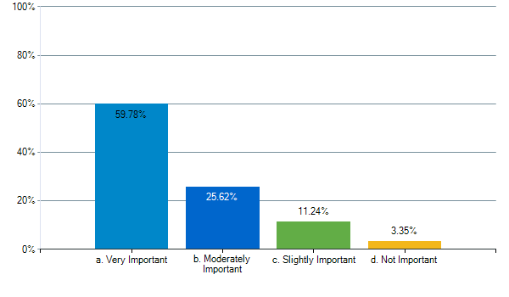
7. Provide activities to improve Career and Technical Education (CTE) programs;

Slide 9
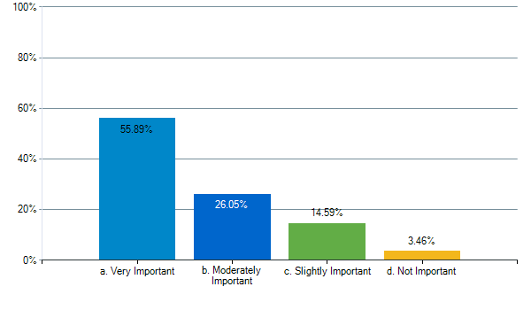
8. Provide activities to ensure the unique needs of English Language Learners are met;

Slide 10
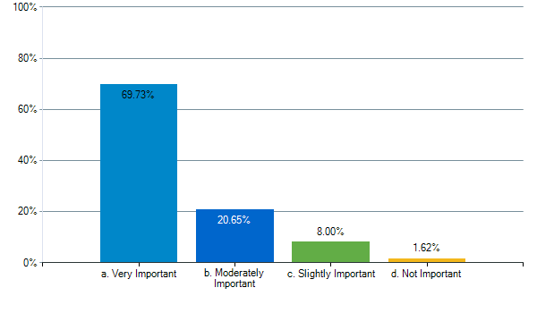
9. Provide activities to ensure the unique needs of students with disabilities are met;

Slide 11
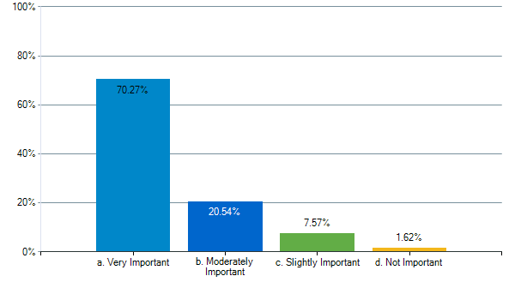
10. Provide activities to ensure the unique needs of students experiencing homelessness and youth in foster care are met, including outreach and service delivery;

Slide 12
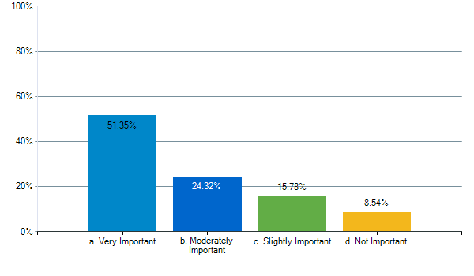
11. Administer and use high quality diagnostic assessments and tools;

Slide 13
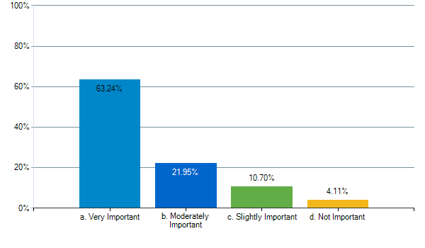
12. Provide training and professional development for teachers and other staff;

Slide 14

13. Provide social and emotional counseling and wellness supports to students and staff;

Slide 15
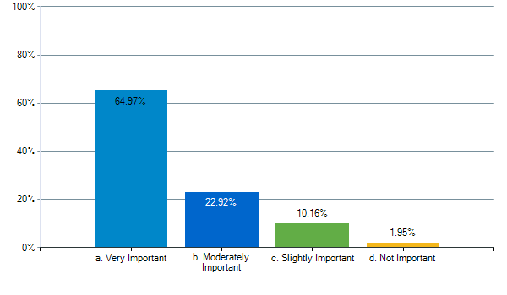
14. Provide information and assistance to parents and families to help them effectively support students;

Slide 16
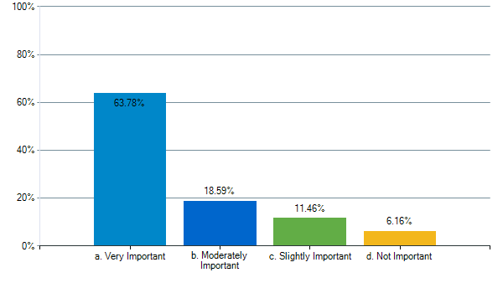
15. Purchase cleaning supplies to sanitize facilities, personal protective equipment and provide staff training on safety procedures.

