Slide 1
11A3: Consider Approval of Attendance Boundary for Phelan Elementary School
February 15, 2022

Slide 2
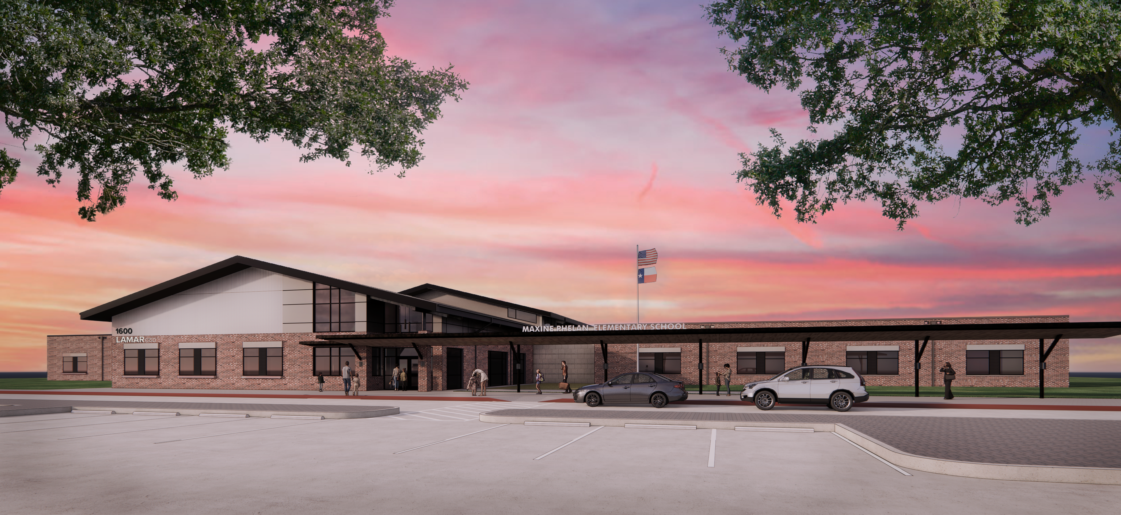
Notes:
With Phelan Elementary opening in August 2022, Lamar CISD needs to rezone in order to create the population of students who will attend this campus.

Slide 3
Rezoning Opportunities
The goal of rezoning is to more evenly distribute enrollment across our elementary schools.
Currently, approximately one-third of Lamar CISD’s elementary schools are over capacity. Several schools, however, are well under their enrollment caps.
By rezoning, students at all impacted schools can receive improved learning experiences. Rezoning to more evenly distribute our students across schools will relieve stretched resources and overcrowded classrooms in schools currently over enrollment and will increase per-capita funds and resources to schools currently under enrollment.
Notes:
We are seeing significant growth in some areas across our district.
It’s projected to continue for the next few years
While we’re excited to build new schools and facilities, we have a responsibility to make good use of our existing resources. We have to take a hard at how we’re currently using existing facilities…current capacity vs. utilization
Currently, approximately one-third of Lamar CISD’s elementary schools are over capacity. Several schools, however, are well under their enrollment caps.
By rezoning, students at all impacted schools can receive improved learning experiences. Rezoning to more evenly distribute our students across schools will relieve stretched resources and overcrowded classrooms in schools currently over enrollment and will increase per-capita funds and resources to schools currently under enrollment

Slide 4
Feedback
The Phelan Attendance Boundary Committee met and discussed the options on January 27 and February 7.
Launched a survey to the potentially immediately impacted community.

Slide 5
Outcome/Survey Results
Notes:
Administration shared current and projected enrollment information with members of the Phelan Elementary Attendance Boundary Committee which included representatives from the following school communities potentially impacted by the zoning decision:
Arredondo Elementary
Hutchison Elementary
Thomas Elementary
Williams Elementary
In addition, Administration distributed a survey to parents in these communities
Discuss Pros of each option

Slide 6
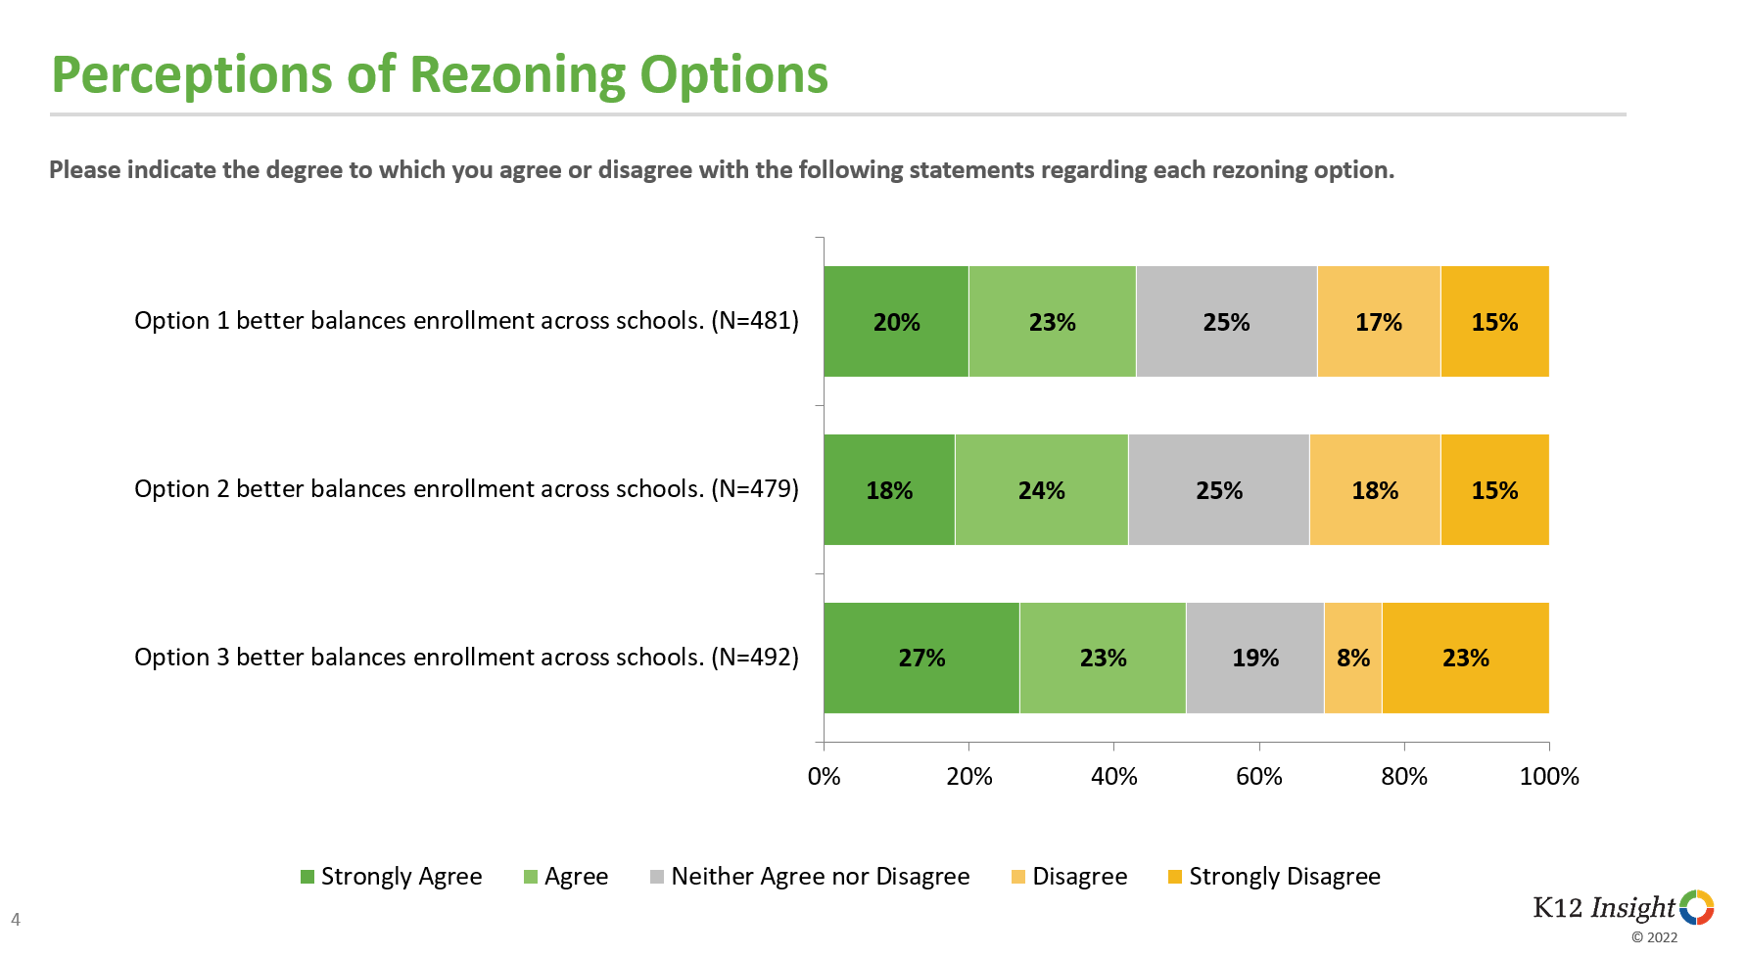
Outcome/Survey Results
Notes:
Administration shared current and projected enrollment information with members of the Phelan Elementary Attendance Boundary Committee which included representatives from the following school communities potentially impacted by the zoning decision:
Arredondo Elementary
Hutchison Elementary
Thomas Elementary
Williams Elementary
In addition, Administration distributed a survey to parents in these communities
Discuss Pros of each option

Slide 7
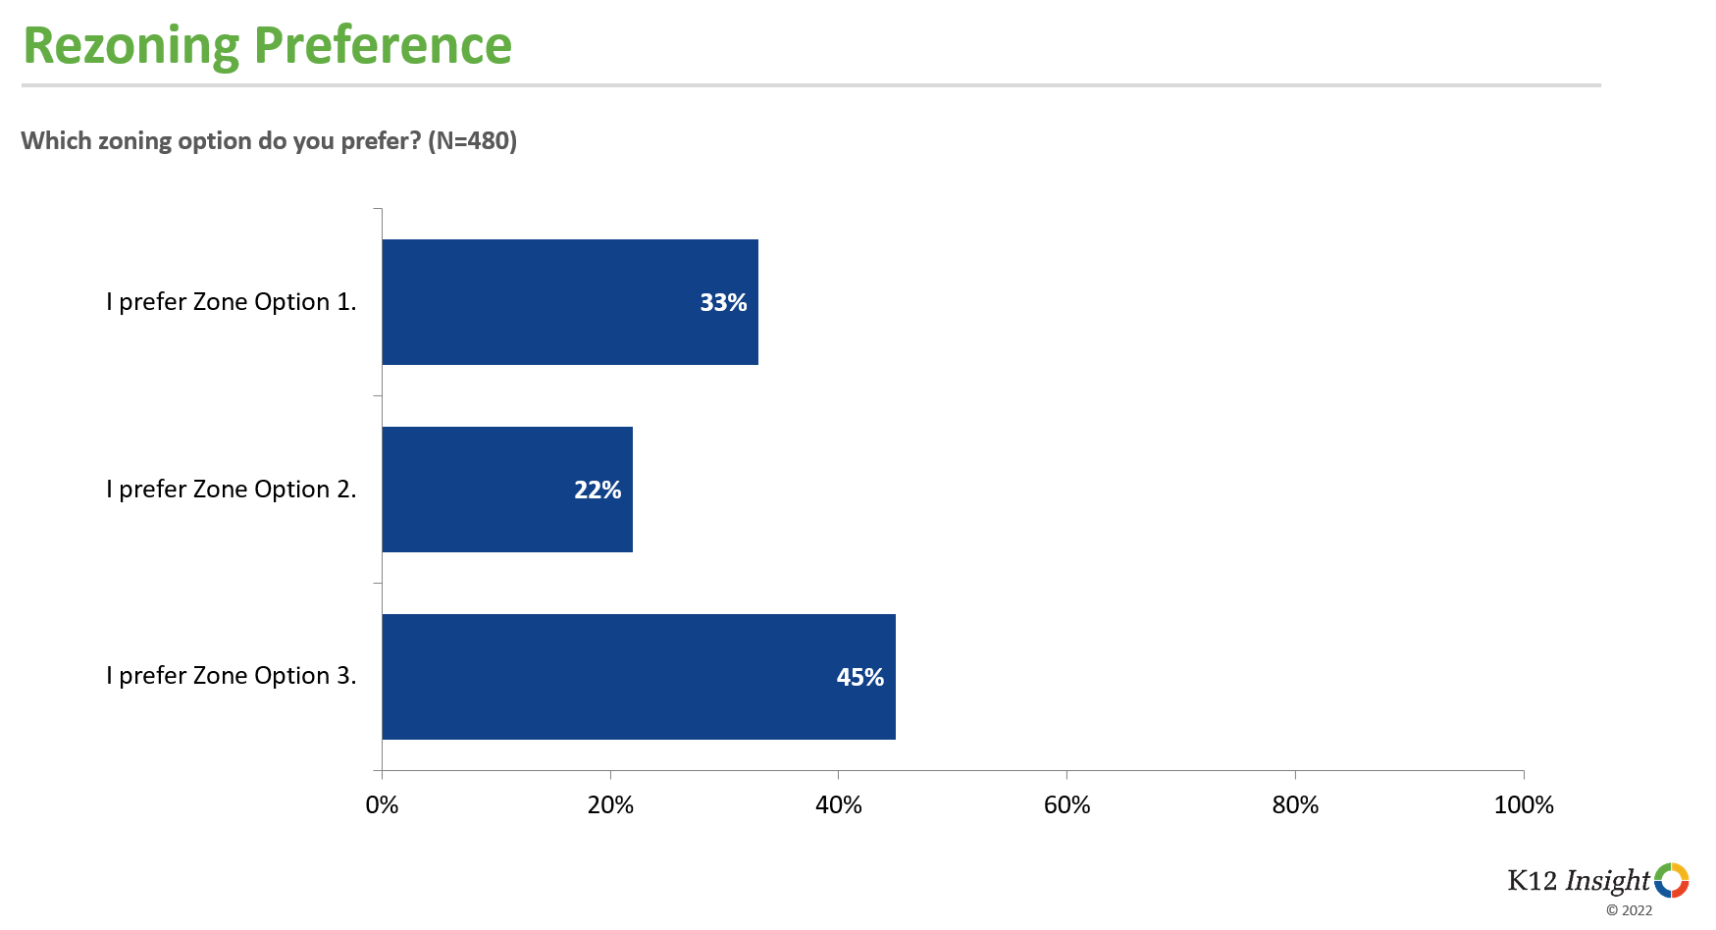
Outcome/Survey Results
Notes:
Administration shared current and projected enrollment information with members of the Phelan Elementary Attendance Boundary Committee which included representatives from the following school communities potentially impacted by the zoning decision:
Arredondo Elementary
Hutchison Elementary
Thomas Elementary
Williams Elementary
In addition, Administration distributed a survey to parents in these communities
Discuss Pros of each option

Slide 8
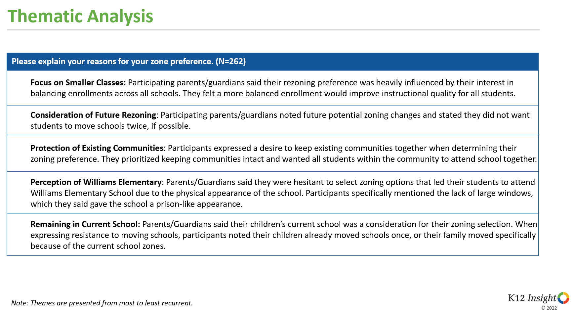
Outcome/Survey Results

Slide 9
Outcome/Survey Results
Option 1 | Option 2 | Option 3
Veranda voice is heard -entire community together |  | Balances enrollment
Easy access to school |  | Veranda voice is heard
Well-defined boundary by 59 |  | Long-range benefits
One color track |  | Positive impact for classrooms resources
Fewer campuses are impacted |  | Relief to Thomas for enrollment
Doesn’t move AES kids on 59 side |  | Lower enrollment for all 5 schools
Logical

Slide 10
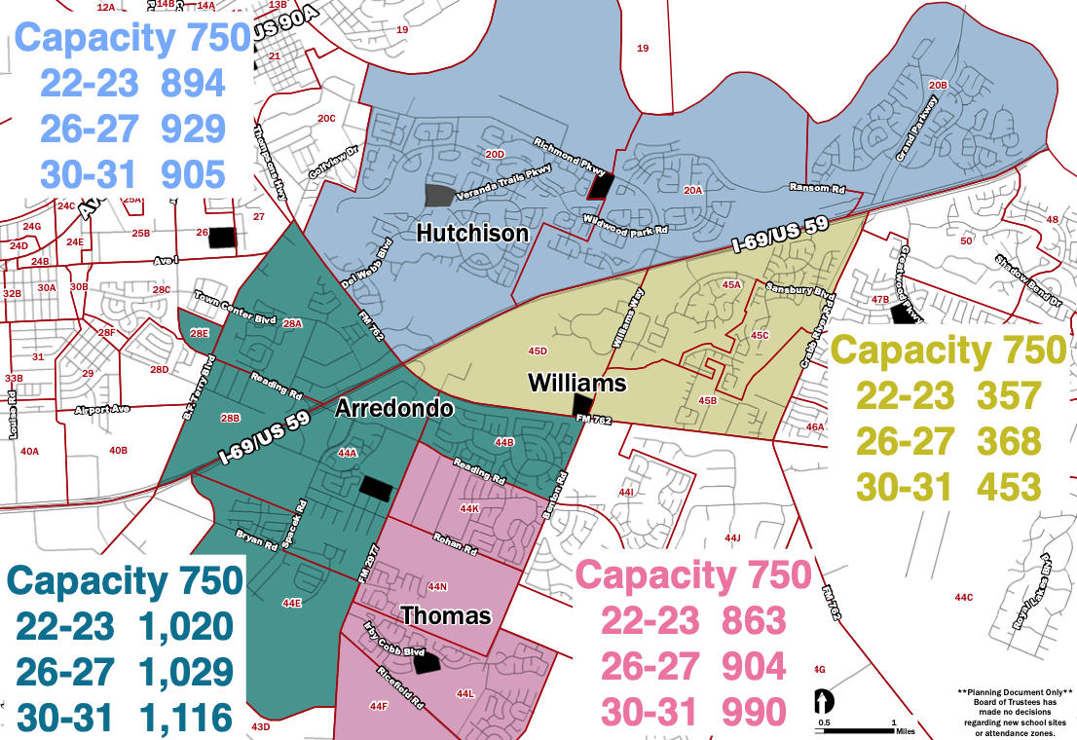
Current Attendance Zones

Slide 11
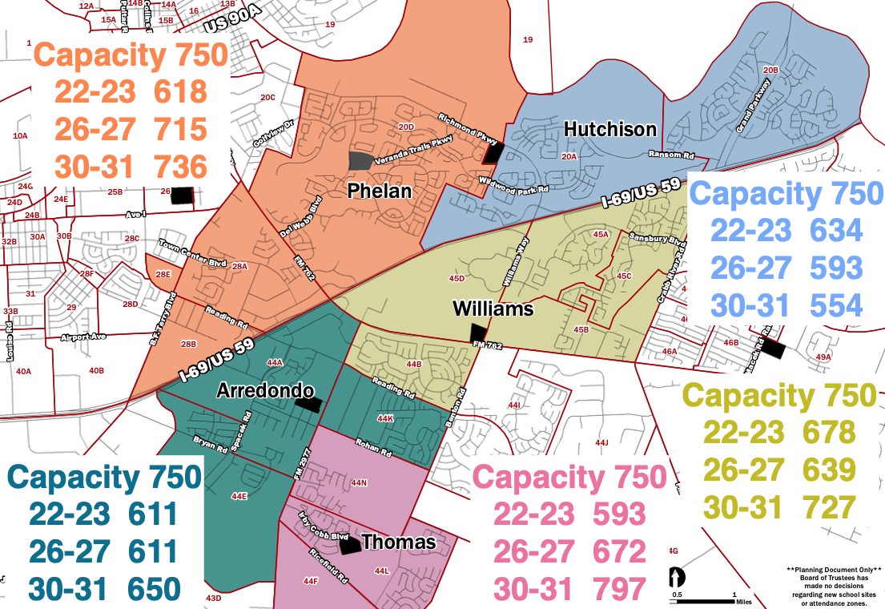
Option 3 Attendance Zones

Slide 12
QUESTIONS?

